Slide 1
Object Oriented Programming
Prof. Varsha Dange

Slide 2
Section 2 Lecture – 21
Prof. Varsha Dange

Slide 3
Exception Handling
Exception is an abnormal condition.
Exception is an event that It terminates the program abnormally and rest of program will not executed.
disrupts the normal flow of the program during program execution.
All exceptions are occur only at run time .
Exception are objects thrown to the JVM.
Exception Handling - handle the exception so that normal flow of the program can be executed.
Two ways for exception handling-using : try-catch ,using throws
s

Slide 4
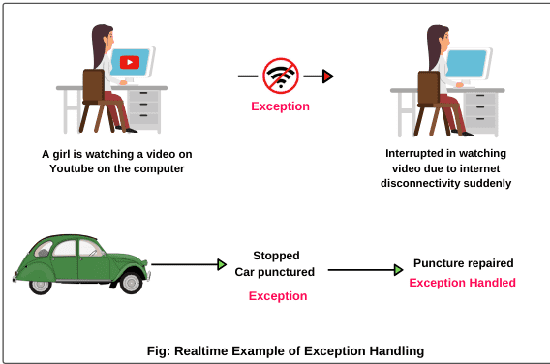
Exception

Slide 5
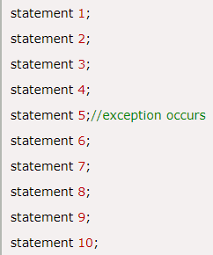
Advantage of Exception Handling
To maintain the normal flow of the application.
An exception normally disrupts the normal flow of the program that is why we use exception handling.
In eg, statement 6 to 10 will not be executed.

Slide 6
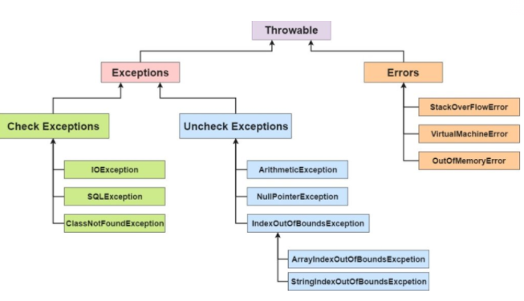
Exception Hierarchy

Slide 7
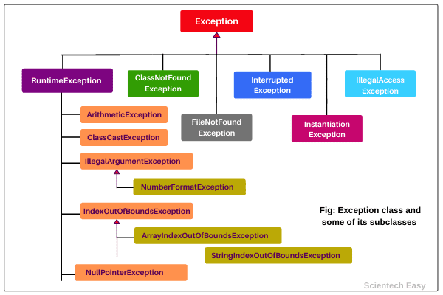

Exception Hierarchy

Slide 8
Types of exceptions
Throwable is the super class.
there are three types of exceptions:
Checked Exception
Unchecked Exception
Error
Difference between error and exception
Errors indicate that something severe enough has gone wrong,
the application should crash rather than try to handle the error.
Eg. OutOfMemoryError , VirtualMachineError etc.
Can not handle error
Exceptions are events that occurs in the code.
A programmer can handle such conditions and take necessary corrective actions.
Can handle exception

Slide 9
Checked exceptions
Checked exceptions are those exceptional conditions that are checked by compiler at the compile time.
Checked by compiler.
A checked exception forces you to either use try-catch or throws keyword.
If not handles properly, it will give a compile-time error message.
e.g. – IOException, SQLException, InterruptedException , FileNotFoundException, ClassNotFoundException etc.

Slide 10
Unchecked exceptions
Unchecked exceptions are those exceptional conditions that are not checked by compiler at the compile time.
Unchecked exceptions are checked at runtime.
Not Checked by compiler, checked by JVM
An unchecked exception not forces you to either use try-catch or throws.
All unchecked exceptions are direct subclasses of RuntimeException.
e.g. – NullPointerException, ArithmeticException etc.

Slide 11
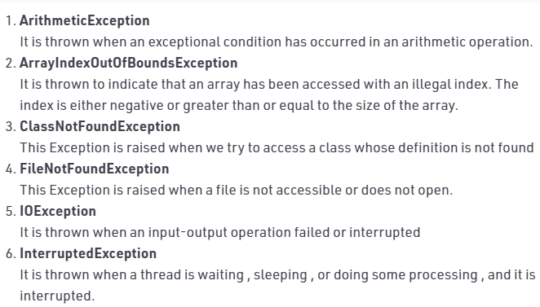
Built-in Exceptions

Slide 12
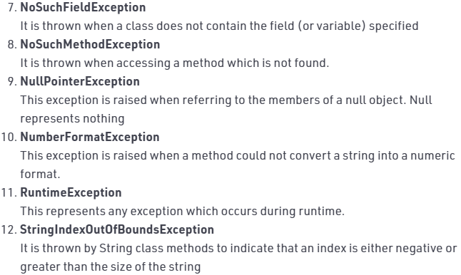
Built-in Exceptions

Slide 13
Difference between checked & unchecked
checked | unchecked
Checked exceptions checked at compile time. | Unchecked exceptions not checked at compile time
The compiler checks a checked exception. | The compiler does not check these types of exceptions.
These types of exceptions can be handled at the time of compilation. | These types of exceptions cannot be a catch or handle at the time of compilation, because they get generated by the mistakes in the program.
They are the sub-class of the exception class. | They are runtime exceptions and hence are not a part of the Exception class.
It forces to use try –catch block | It not forces to use try –catch block
Examples of Checked exceptions: File Not Found Exception No Such Field Exception Interrupted Exception No Such Method Exception Class Not Found Exception | Examples of Unchecked Exceptions: No Such Element Exception Undeclared Throwable Exception Empty Stack Exception Arithmetic Exception Null Pointer Exception Array Index Out of Bounds Exception Security Exception

